Slide 1
Wake County Estate Planning Council
“Education Planning” January 15, 2019
Nerre Shuriah, JD, LLM, CEPA™
SVP, Wealth Planning Director
First Citizens Bank Wealth Management
nerre.shuriah@firstcitizens.com

Slide 2
Education: At a Glance
Trends in Employment & Education
Education Planning Tools (handout)

Slide 3
Benefits of Education
Increases the chance that adults will move up the socioeconomic ladder and reduces the chance that adults will rely on public assistance.
Higher education is associated with healthier lifestyles, reducing health care costs. In 2012, only 8% of four-year degree-holders surveyed smoked, compared to 20% with an Associate’s degree and 25% with a high school diploma alone. Among 25-34-year-olds, 85% of those with a Bachelor’s degree and 71% with an Associate’s degree reported exercising weekly, compared to 60% of those with no post-secondary education.
Adults with higher levels of education are more active citizens than others and are more involved in their children’s activities. Among people ages 25-44, 73% of Bachelor’s degree-holders and 58% of Associate’s holders voted in the 2012 presidential election, compared to 42% of those with a diploma alone. In 2012, 17% of those with no post-secondary education reported volunteering, compared to 29% of those with some college or a two-year degree and 42% with a Bachelor’s or higher.
Individuals with higher levels of education earn more, pay more taxes, and are more likely than others to be employed.
The unemployment rate for individuals with at least a bachelor’s degree has consistently been about half of the unemployment rate for high school graduates.

Slide 4
Education & Income
This chart shows an estimate of the median pre-tax annual earnings of full-time workers ages 25 and older at progressive levels of education
 | Amount of Education | Gross Earnings
1 | Doctoral Degree | $100,100
2 | Master’s Degree | $75,200
3 | Bachelor’s Degree | $61,400
4 | Associate’s Degree | $46,000
5 | Some college, no degree | $41,700
6 | High School Graduate | $36,800
7 | High School Dropout | $27,200

Slide 5
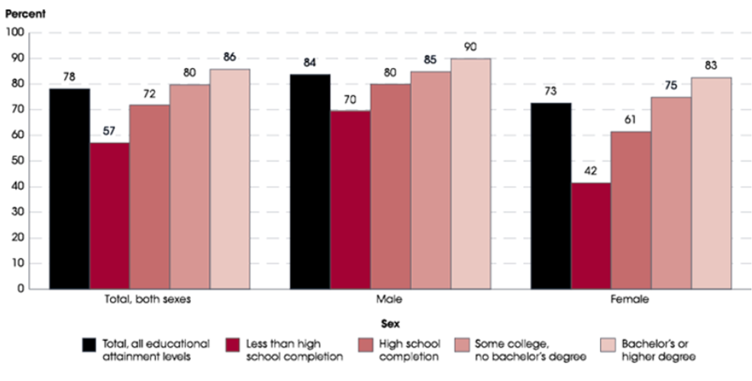
Employment Rates by Level of Schooling
This 2017 chart shows employment rates of full-time workers ages 25 to 34 years old divided by gender and level of education
*Source: National Center for Education Statistics
Notes:
-Women have longer life spans than men and face a greater disparity of pay.¹
-Women earn 90% of what men are paid until age 35, then when earnings are typically at their peak, women earn 74-82% of what men are paid.²
-Women spend on average 13 fewer years working than men.³
-66% of caregivers are female.⁴
¹“Women lagging in retirement saving”, CNBC.com, March, 2015
²www.aauw.org
³W²www.wiserwomen.org/pdf_files/ebook/chapterone.pdf
⁴ SSA.gov ⁴www.caregiver.org Women and Caregiving: Facts and Figures 12/31/2003

Slide 6
The Future of Jobs
Jobs that will be gone in 20 years | Jobs that will exist in 20 years | New Jobs that don’t exist now
Drivers & Delivery & Courier & Postmen | Human Resources | Productivity Officer
Farmers & Fishermen | Sales Managers | Excess Capacity Manager
Broadcasters | Marketing Managers | Drone Manager & Private Industry Air Traffic Controller
Jewelers | Public Relations | Seed Capitalists
Fast food cook | Chief Executives | Avatar Designer/ Relationship Manager
Printers, Publishers & Proofreaders | Event Planners | Self-driving car mechanic
Cashiers & Telemarketers & Retail Sales & Loan Officers | Writers | Autonomous transportation specialist
Compensation & Benefits Managers | Software Developers | Personal Medical or Genetic Interpreter
Travel Agents | Editors | Human technology integration specialist & privacy manager
Dispatchers | Graphic Designers | Wholeness Mentor, Medical Mentor & End-of-Life Coach
Bookkeepers & Accountants & Paralegals | Dentists & other Medical Roles | 3D Printer Engineer, 3D Food Printer Engineer
Social Media Professionals | Mental Health & Substance Abuse Social Worker | Alternate currency banker
Sports Officials & Referees | Clergy | Business Colony Manager
Secretaries & Receptionists | Plumber | Global System Architect

Slide 7
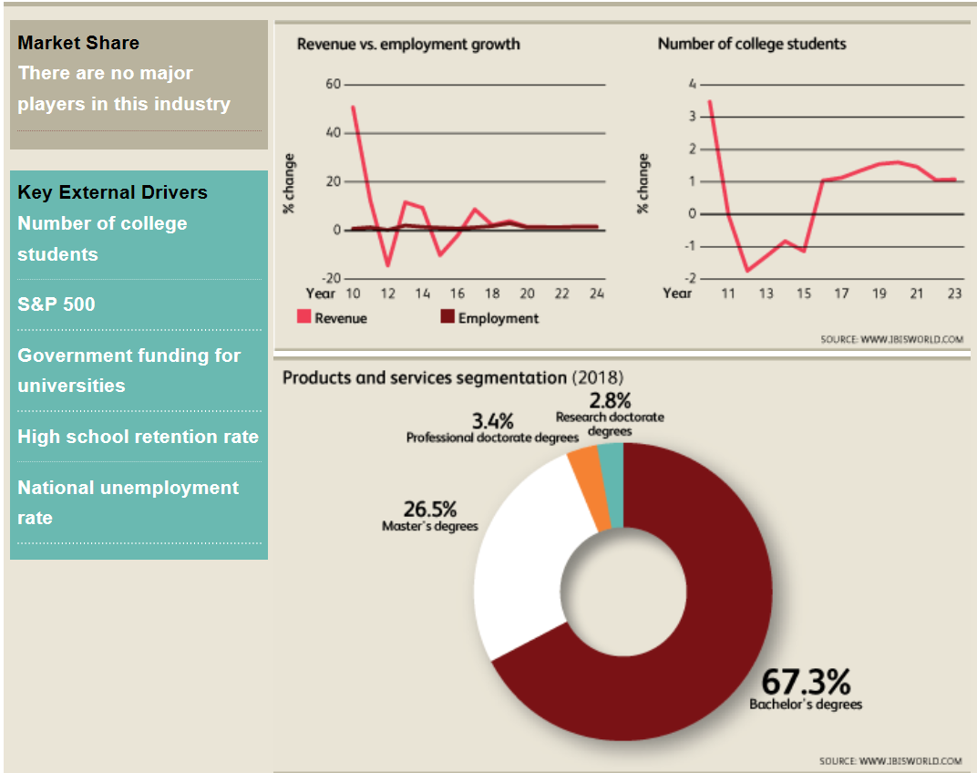
About the Education Industry
Rising levels of disposable income and strong high school retention will increase college enrollment
However, student’s expectation of affordability, better facilities and services has increased pressure on colleges/universities

Slide 8
Higher Education Outlook - Negative
S&P and Moody’s outlook for higher education remains negative for second year
College/University aggregate operating revenue will not keep pace with expense growth (programs, facilities and technology).
A growing number of universities have weaker revenue growth (tuition & government appropriations) and it will remain constrained due to declining high school grads (decreasing population numbers), better employment, less international enrollment, and TCJA.
Public universities will face more strain than private universities (especially ones with alternate uncorrelated streams of income, ex. patient care revenue, IP, athletics)
Attempts to control costs will result in longer-term challenges related to programmatic and capital investment
Stability of Colleges/Universities
Less stable | More stable
Public Universities Small & Mid-sized Schools Schools that rely on tuition only Regional Public Universities | Private Universities Large Universities Schools with varied revenue streams
Notes:
Recent mergers and closings indicate a trend of private college consolidation – particularly small private liberal arts colleges, or catholic colleges not near a catholic center. Harvard Business School Professor Clayton Christensen predicted half of country’s colleges/universities will close in 10 years. (Forbes) Moodys’ in 2015 predicted closures of small private colleges would triple and mergers would double.

Slide 9
Disruptive/Online Learning – May be the future
With rising college costs, many are questioning the need for a traditional humanities based 4 year college education
Enrollment at traditional schools has steadly declined, but online learning continues to rise (20% of students are in a mostly online program)
Increasing number of education start-ups (boot camps, 1 – 2 year tracks, certifications) geared to a specific job or skill are an alternative to a bachelors degree
Online classes are increasing from traditional schools as well new companies that teach innovative ways of learning (critical thinking)
Some employers have dropped college education from its hiring requirements (Google, New York Times, Ernst & Young)

Slide 10
Can you afford a higher education?
Yourself
Children
Grandchildren
Job retraining
Second career
Retirement Income
College
Graduate School
Other certifications/licenses
K thru 12
Help Parents

Slide 11
2018-2019 Tuition Comparison
Public
$28,444
Private
$55,960
Notes:
The College Board reports that a "moderate" college budget for an in-state public college for the 2016–2017 academic year averaged $24,610. A moderate budget at a private college averaged $49,320. This is tuition and fees only.
The quoted costs do not include housing, meals, books, supplies, transportation, personal.
Think these numbers are scary now? They increase by an average of 5% each year.

Slide 12
Tuition and Fees - past 20 years
Private Universities
+157%
Out-of-State Public Universities +194%
In-State Public Universities +237%
Notes:
In an era of stagnant family incomes and diminished savings, the result is increased financial strain and growing reliance on borrowing to pay for college.
AWI (Average Wage Index) indicates that wages have risen only about 59% over the past 20 years as compared to an average 196% increase in tuition.

Slide 13
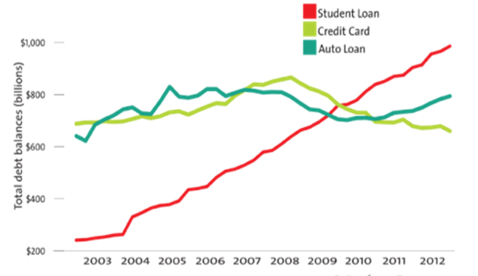
Student Loan Debt
Student loan debt has surpassed both credit card and auto loan debt amongst consumers
Student loan debt is the second highest consumer debt category
The average student in the Class of 2016 graduated with $37,172 in student loan debt
90+ Day Delinquency Rate: 11.2%
68% of 2015 bachelor’s degree recipients graduated with student loan debt
Source: Federal Reserve Bank of New York
Notes:
Student loan debt is now the second highest consumer debt category $1.5 trillion in federal loans, $64.2 billion in private student loans - behind only mortgage debt - and higher than both credit cards and auto loans.
Mortgage 30 day delinquency rate is 5%

Slide 14
Student Debt Immobilizes the Future
Average age of pay-off of student loans? The standard repayment plan for federal student loans puts borrowers on a 10-year track to pay off their debt, but research has shown the average bachelor's degree holder takes 21 years to pay off his loans. Many people won’t pay it off until age 45.
Wage stagnation for Millennials? Young adults between the ages of 21 and 24 who graduated college in 2000 and entered the workforce rather than grad school earned an average of $18.41 an hour. Today, that figure is $17.94, a 2.5 percent drop. Average millennial salaries are disproportionately low compared to national average and are 20% lower than baby boomers’ salaries when they were the same age.*
Effect on credit and financial future? An increase in student debt has led to a decrease in home ownership. Students who graduated from college in 2015 will have to delay retirement until the age of 75, in part because of the increasing burden of student debt.
*Forbes, “Why Are Millennial Salaries Disproportionately Low?” 9/28/2018

Slide 15
Common Ways to Lower College Costs
Need-Based Aid
Free Application for Federal Student Aid (FAFSA)
Your current income and assets and your child’s current income and assets are run through a formula known as federal methodology
Result is Expected Family Contribution (EFC)
Amount of money that you’ll be expected to contribute to college costs before you are eligible for aid
Financial need = Cost of attending college – EFC
Varies by college
Other criteria are factored in, such as how many family members are in college at the same time as well as how close you are to retirement age
Example: You fill out the FAFSA, and your EFC is calculated to be $5,000. Assuming that the cost of attendance at College A is $18,000 per year and the cost at College B is $25,000, your child's financial need is $13,000 at College A and $20,000 at College B.
Notes:
Only a small percentage of the average student's overall financial aid package consists of scholarships. So, while scholarships are certainly worth researching, such research should not be at the expense of filling out the federal government's financial aid form (the FAFSA) or any applicable college or state financial aid forms.

Slide 16
Assets Not Reported on FAFSA
Be careful about completing the FAFSA, not all your assets are reported.
Items which should not be included are:
Retirement Assets – non-education IRAs, 401k, 403b, SEP-IRA, SIMPLE, Roth IRAs, Pension Plans, Keough Plans are not reported on FAFSA
Primary Home Equity*
Life Insurance Policies – cash value is not considered an asset
Annuities
Family Business* (if less than 100 full-time employees)
Family Farm*
College grant and scholarships that were not reported to the IRS as income
Personal possessions – jewelry, cars, furniture, boats, computers, stamps, coins, art, wine collections, etc.
*These are asked about on the CSS/Financial Aid Profile used by 250 private colleges and universities

Slide 17
Education Plan Tools Comparison
 | 529 College Savings Plan | Coverdell Education Savings Account | Outright Educational Gift | UGMA/UTMA
How much can you invest? | Limits vary per state; some states in excess of $300,000. | $2,000 maximum annual per beneficiary. | Unlimited payments if made directly to the educational institution. | Unlimited contributions.
Tax treatment | Earnings grow tax-deferred. Qualified withdrawals are federally tax-free. Contributions may be deductible for state income tax. | Earnings are tax-free if used for the student’s qualified education expenses. | N/A | A portion of earnings are tax-free. Another portion may be taxable at the child’s rate, which is usually lower than an adult’s. “Kiddie Tax” may apply.
Who controls the account? | The account owner (donor). | Responsible individual maintains control of the account until all assets are distributed. | N/A | Child may assume control of the account once the custodianship terminates.
Gift and Estate Tax Benefits | Can contribute as much as five times the current annual exclusion for gift tax in one year without triggering gift taxes. Contributions are considered completed gifts and may be removed from contributor’s estate. | Contributions are considered completed gifts for estate tax purposes. | Unlimited in amount if made directly to the educational institution. Payments are not includible in the donor’s estate. | Contributions are considered completed gifts for estate tax purposes. However, if the donor is the custodian and dies prior to the child’s age of majority, the account may be included in the taxable estate.
Restrictions on using the money | Withdrawals must be used for qualified higher education expenses or else earnings are subject to a 10% penalty plus income taxes. | Withdrawals must be used for qualified elementary, secondary, or higher education school expenses, otherwise earnings are taxed and may be subject to a 10% penalty. | Payments are limited to direct payments of tuition and fees (may not be used for books, room, board, etc.) | Withdrawals can pay for higher education, but also may be made for non-educational needs of the child.
Impact on financial aid | May not affect financial aid qualifications. Account is considered an asset of the account owner (donor), not the beneficiary. | Participation in financial aid and tuition repayment programs may be affected. | May reduce financial aid available to the student. | May reduce financial aid available to the student. Distributions will be treated as income to the student for aid qualifications.
Notes:
For each of the 4 options, make this chart into 2 slides for each of the options.
Discuss advantages and disadvantages as well as any unique points about each option. The slides after these will be related to scholarships, grants, etc. (reference the first draft to work in some other points such as scholarships, grants, FAFSA, etc.) the powerpoint will conclude with a lengthy case example (needs tweaking as well). Once this whole thing is outlined, if it is possible, work in the case example to flow throughout the powerpoint (like following a client’s timeline from first starting to plan to the end of their college spending cycle)

Slide 18
Education Plan Tools Comparison (cont’d)
 | HEET Trust | Roth IRA
How much can you invest? | $15,000 to stay within the annual exclusion ($30,000 if gift-splitting). Otherwise gifts would be subject to tax or reduce the lifetime exemption | $5,500 maximum annual contribution, plus $1,000 catch up for over 50
Tax treatment | Earnings grow tax-deferred. Qualified withdrawals are federally tax-free. Contributions may be deductible for state income tax. | Earnings are tax-free if withdrawn after the owner is 59½ . Otherwise they are subject to a 10% penalty. Exceptions to the penalty are for distributions of capital, or for education purpose, but they are still taxable
Who controls the account? | Trustee (can be a grantor or non-grantor trust for income tax purposes) | The donor
Gift and Estate Tax Benefits | The trust is irrevocable and removed from donor’s estate if an ILIT is used. They avoid GST taxes. | The account is includible in the owner’s estate
Restrictions on using the money | Withdrawals must be used for qualified higher education expenses (tuition only) or medical expenses | Withdrawals may be used for any purpose
Impact on financial aid | Trust funds are generally required to be reported on FAFSA, even if distributions are restricted | Not included on FAFSA form, not considered an asset of the beneficiary and qualified accounts are excluded

